Slide 1
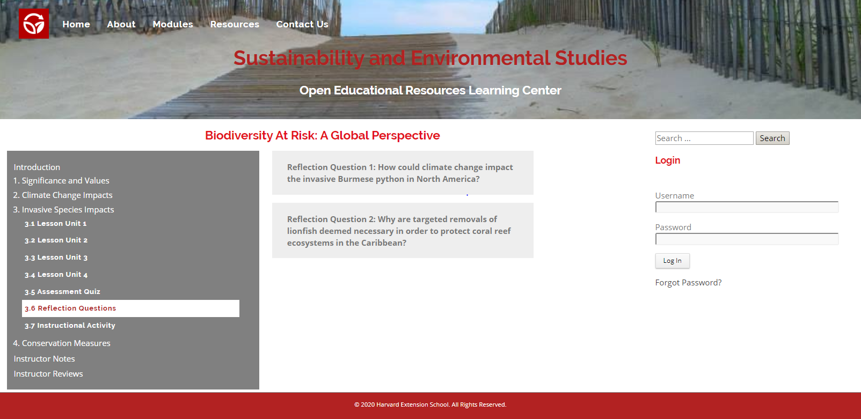
An Open Educational Resource Learning Management System for Sustainability and Environment Studies
Harvard Extension School Video
John Reilly
May 11, 2020

Slide 2
Capstone Project Combining Two Masters Degrees
Completion | Harvard Extension School Degree
Spring 2016 | ALM, Sustainability and Environmental Management
Spring 2020 | ALM, Digital Media Design

Slide 3
Problem and Solution
eLearning Resources for Sustainability and Environmental Studies
Existing eLearning resources are often too general and not focused on what environmental students need to learn.
Demand, though, continues to grow at a rapid pace as online education becomes more prevalent and mainstream.
The Solution was to develop a Learning Management System to complement instructor teachings by delving deeper into environmental topics and issues in order to promote enduring understandings.

Slide 4
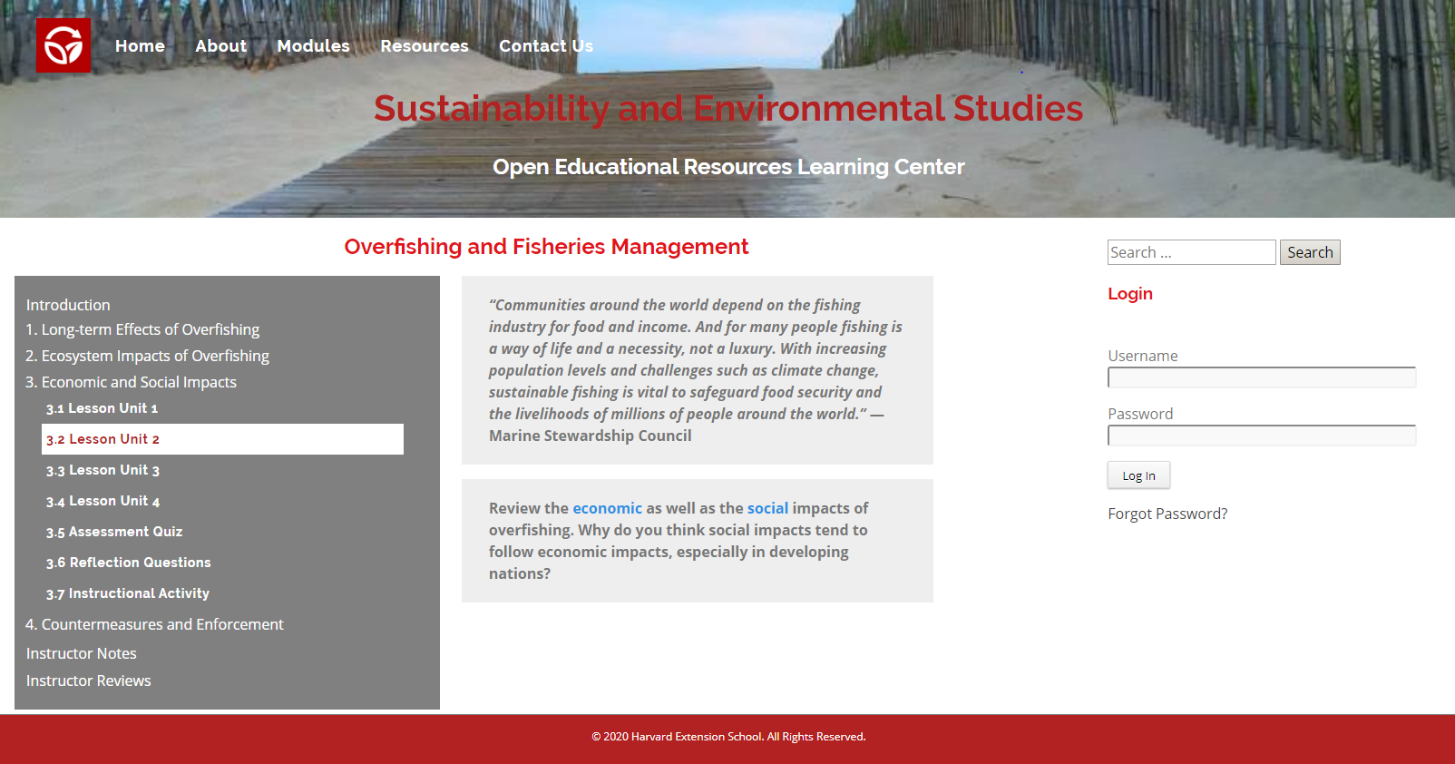
Used Sustainability and Environmental Management Degree to curate Instructional Content

Slide 5

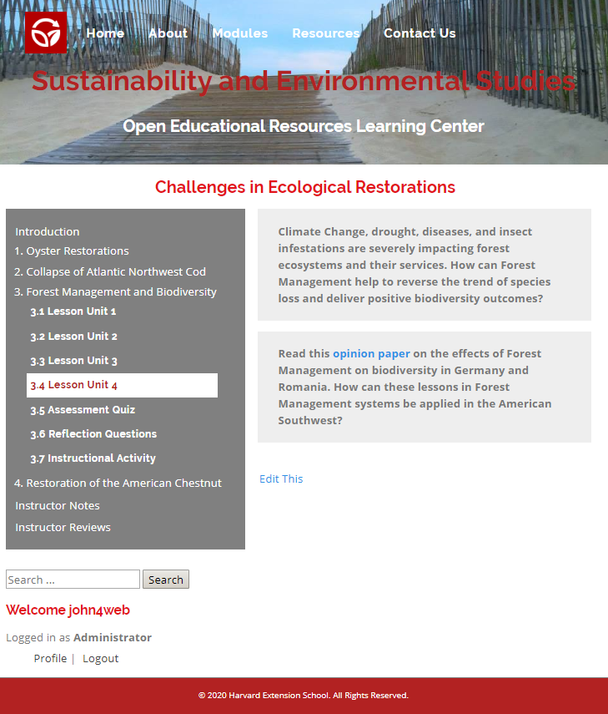
Combined With the Digital Media Design Degree for Website Development

Slide 6
and Instructional Design using Understanding by Design Approach.
Methods to Capture Student Attention and Promote Enduring Understandings
Designing instruction to achieve specific learning goals (Backward Design).
Having a Big Idea as the focus point for instruction and assessment.
Using hooks to capture student attention.
Chunking instructional content into smaller, more manageable pieces to improve retention.
Using repetition in instruction to reinforce learning concepts.
Crafting essential questions and statements of enduring understandings.

Slide 7
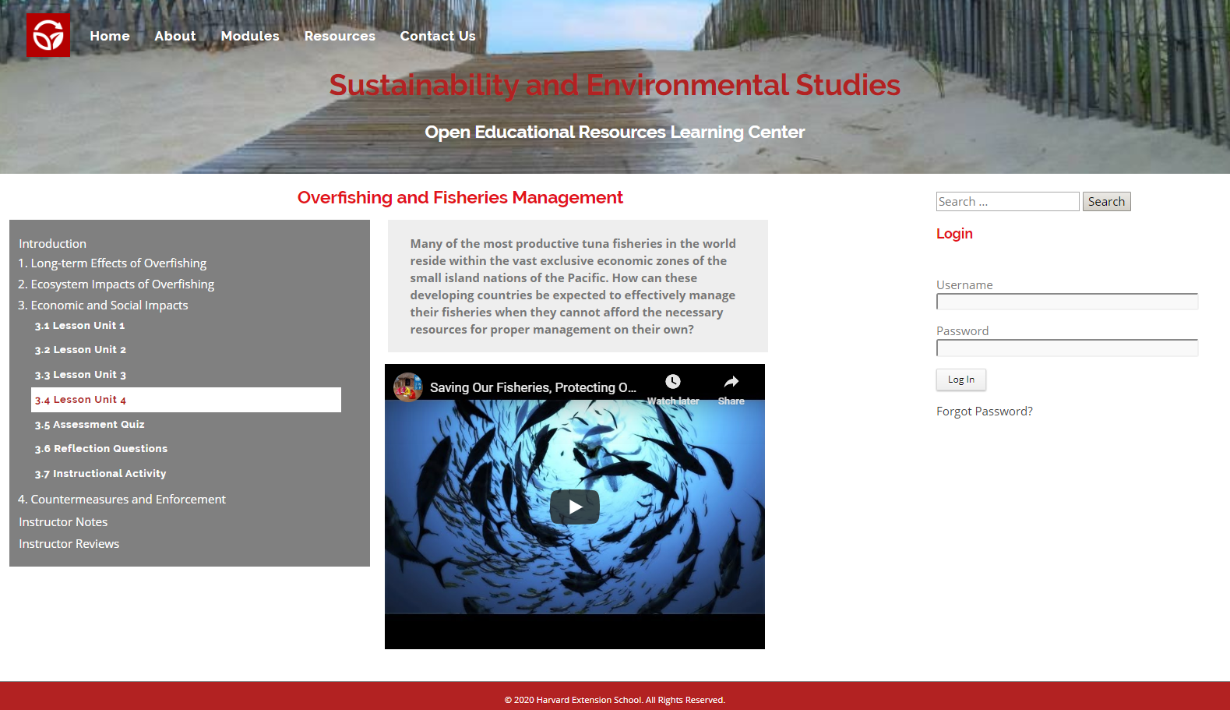
As a Proper Demonstration, Four Lesson Modules with Four Lessons Each Were Curated. More Than Enough Instructional Content for an Entire Semester.

Slide 8
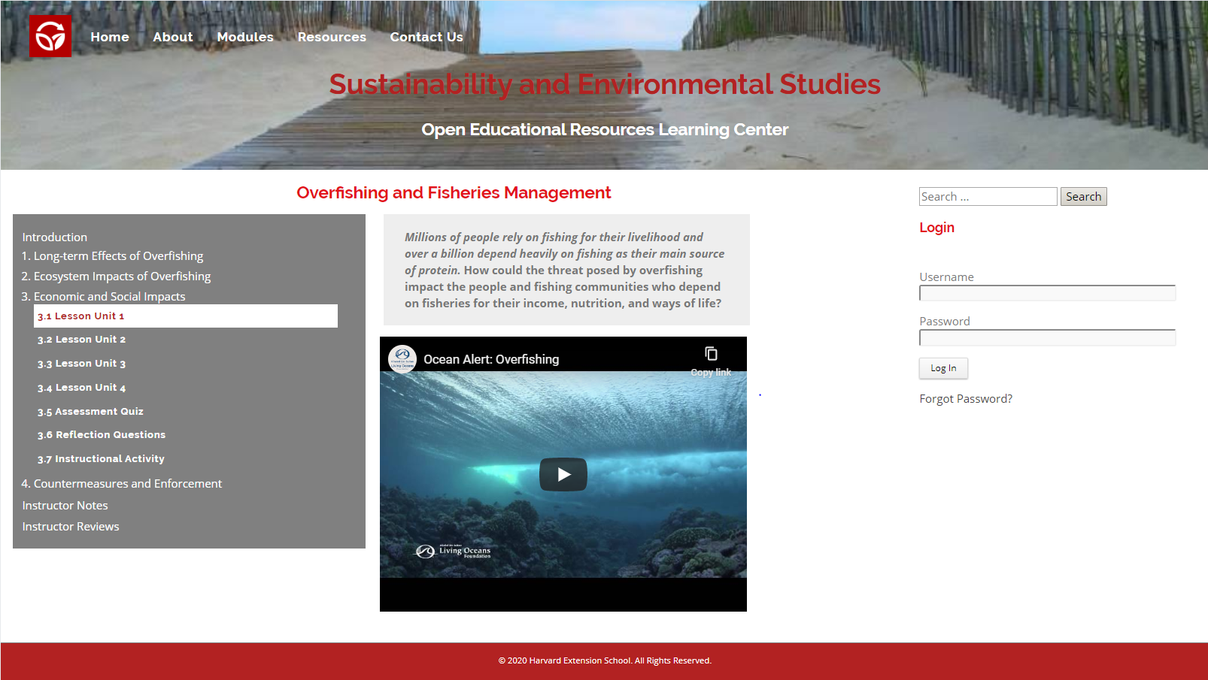
Each Lesson is comprised of four smaller, more manageable sized Lesson Units,

Slide 9
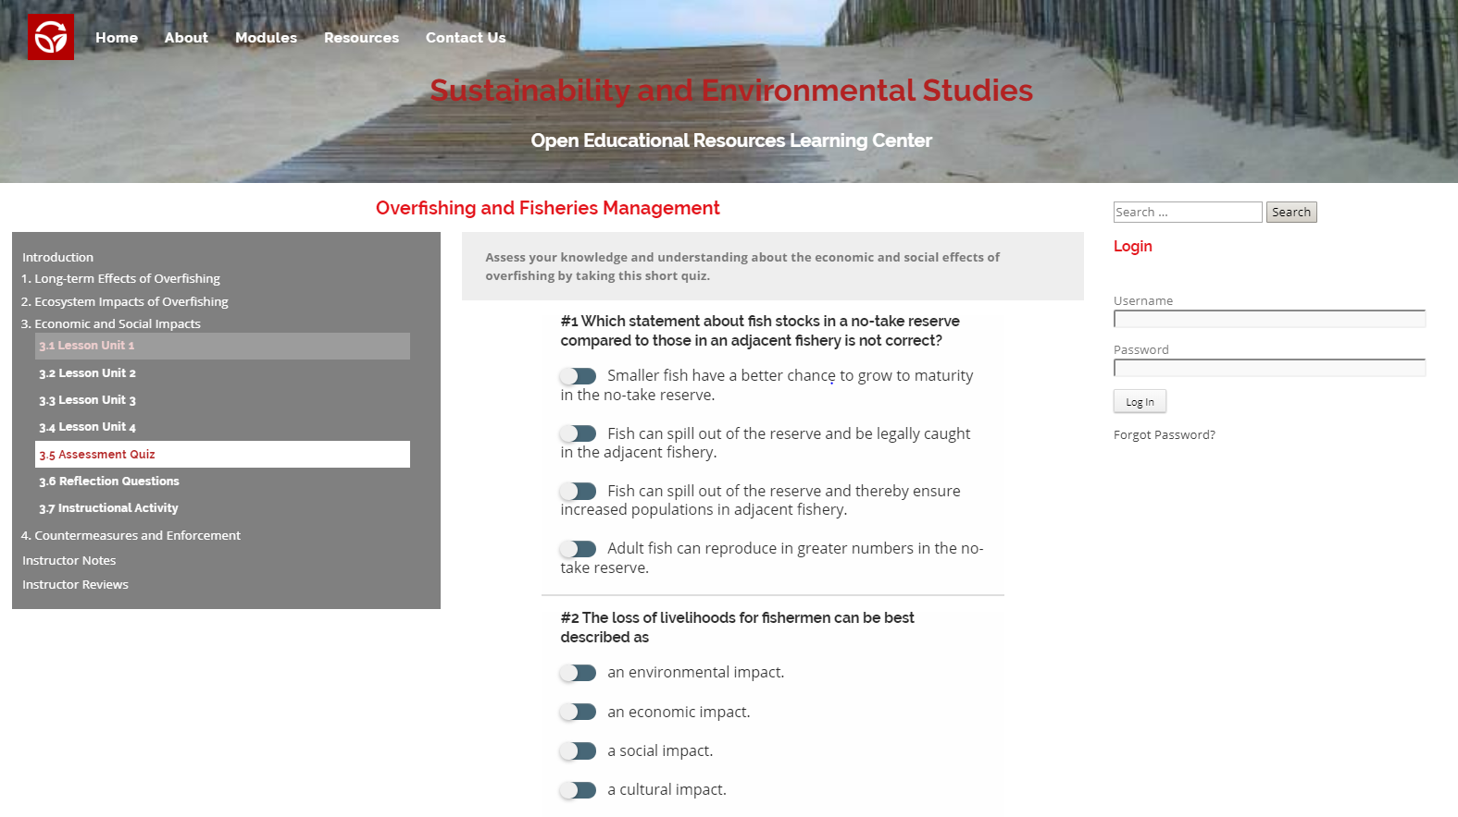
a short Assessment Quiz which consists of five essential questions as indicators of student understanding,

Slide 10
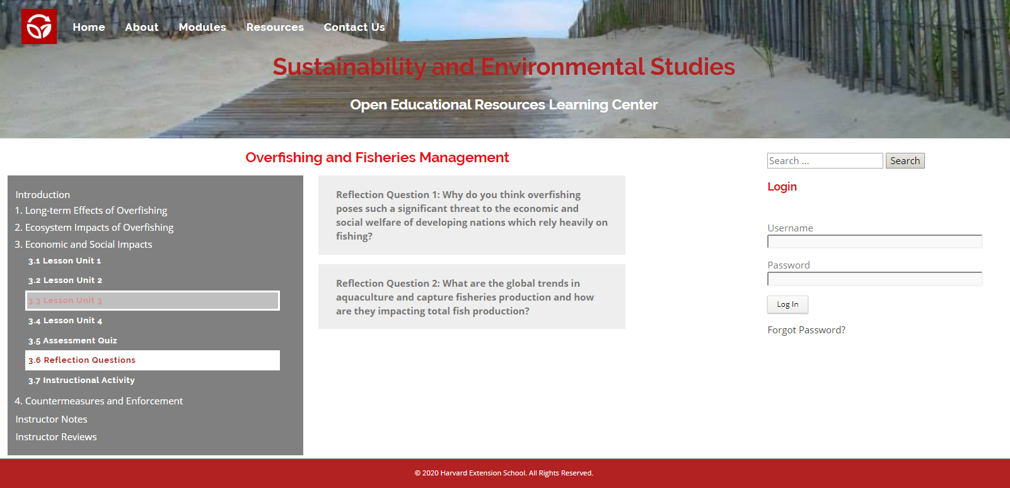
two Reflection questions which can be given as assignments to assess understanding,

Slide 11
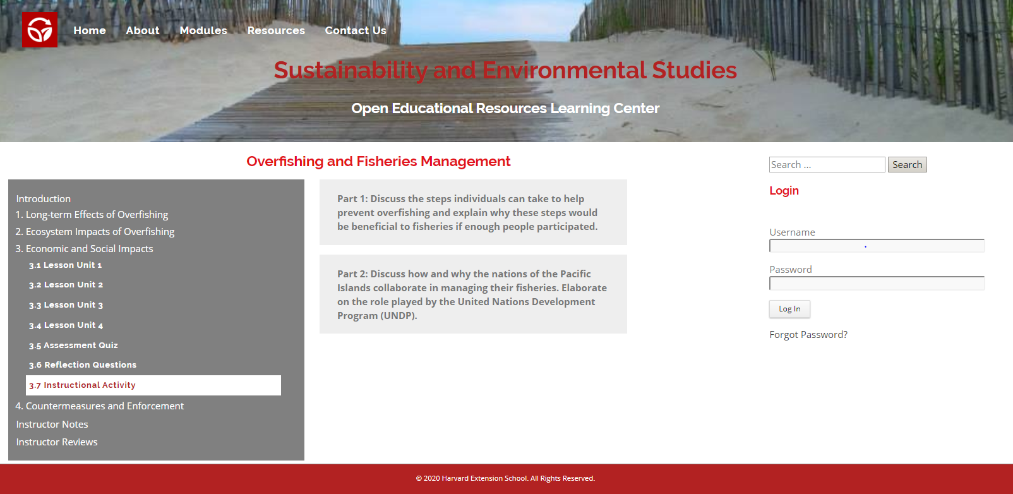
and two Instructional Activities which are meant to reinforce the enduring understandings of the lesson.

Slide 12
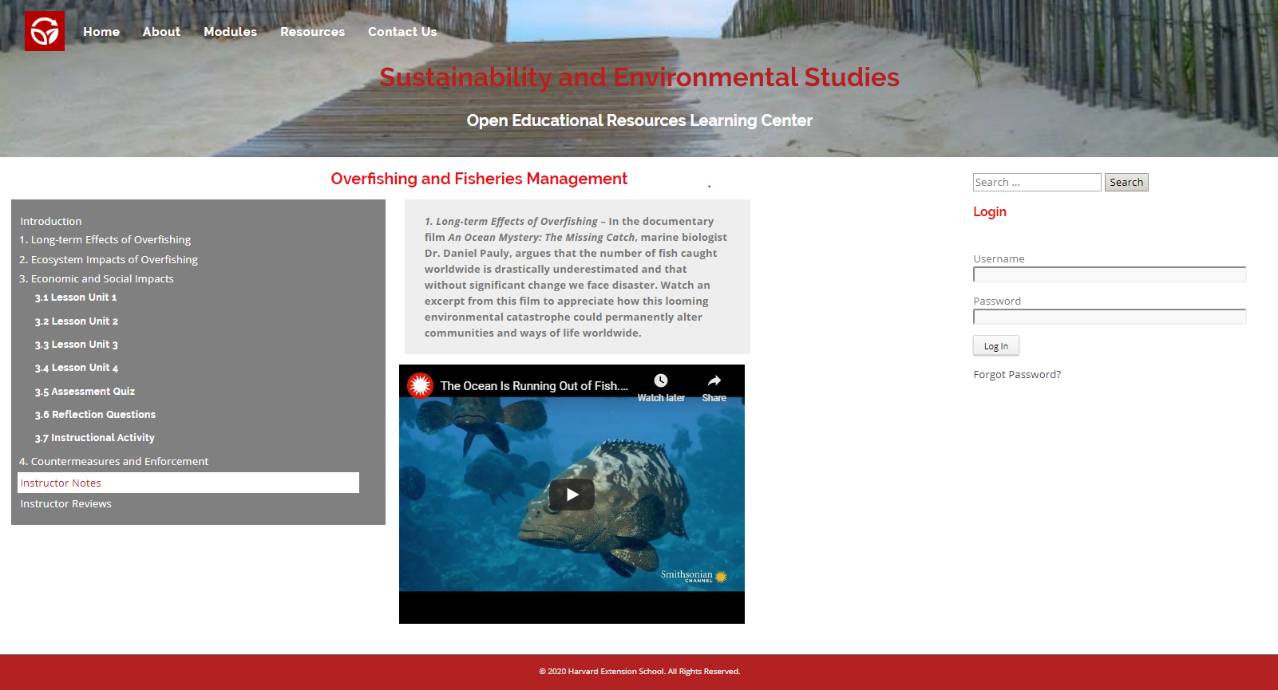
Instructors can supplement lessons with their own curated content by posting to the Instructor Notes and Instructor Reviews sections.

Slide 13
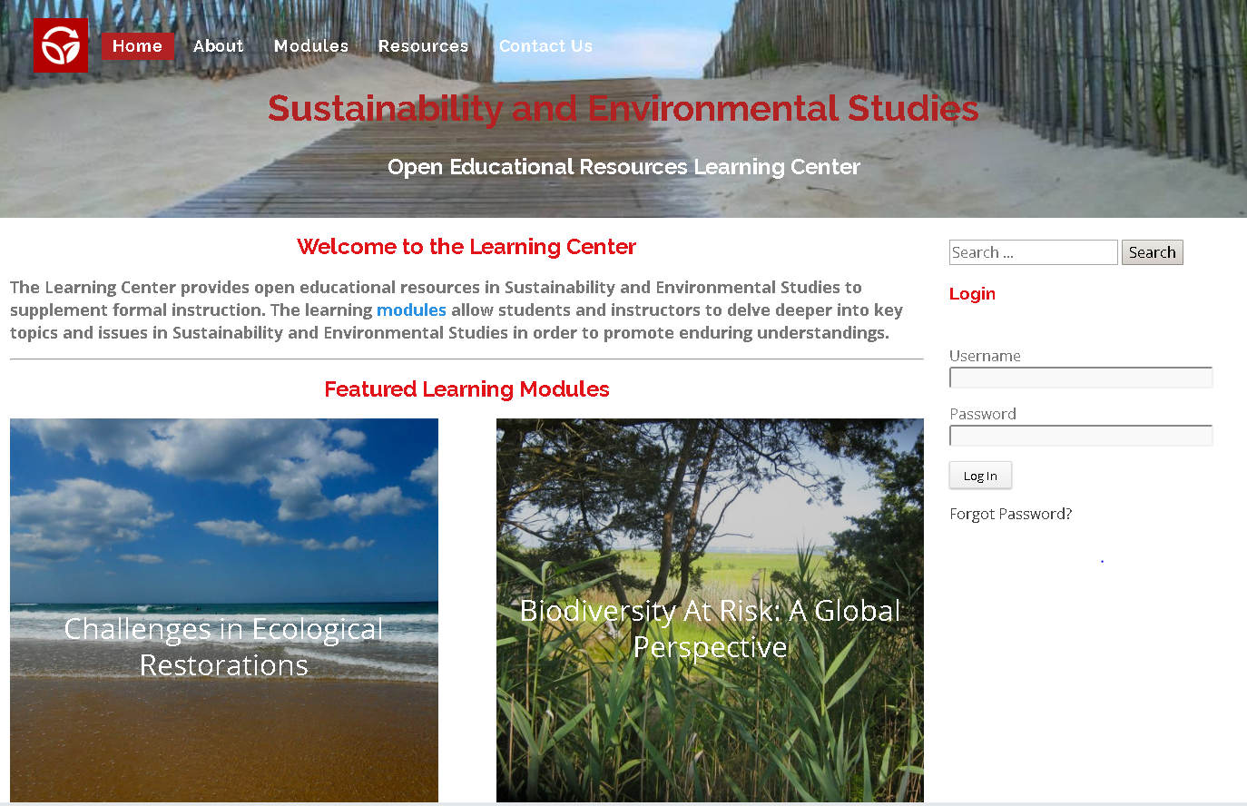
Visit the demonstration site for the LMS at http://johnr1.sgedu.site/wp/.

